Slide 1
Travel-Booking
BY:- TEAM 2

Slide 2
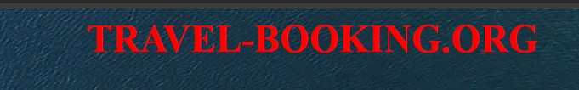
WELCOME TO OUR PROJECT
My Project Theme:- creating a Travel Booking website
PROJECT NAME:- TRAVEL-BOOKING

Slide 3
Implementing a REST API for a Travel Booking website
Here we are building Travel website
When implementing a Travel Booking website, it's important to focus on resource modeling, authentication and authorization, error handling

Slide 4
Tools used:-
Note-pad++
Vs-code
Programing-language used:
HTML
CSS
Basic JAVA-SCRIPT
PYTHON
Flask

Slide 5
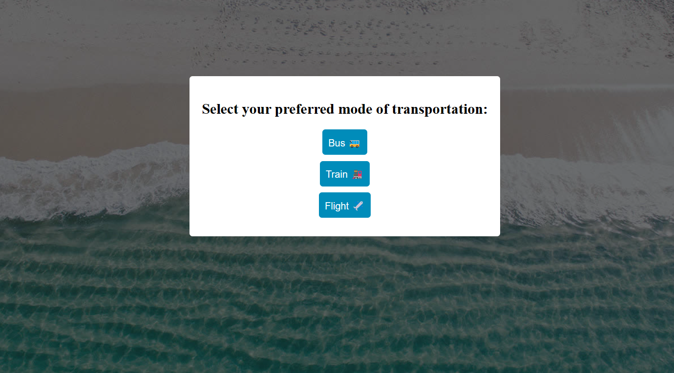
BOOKINGS WE ARE OFFERING:-

Slide 6
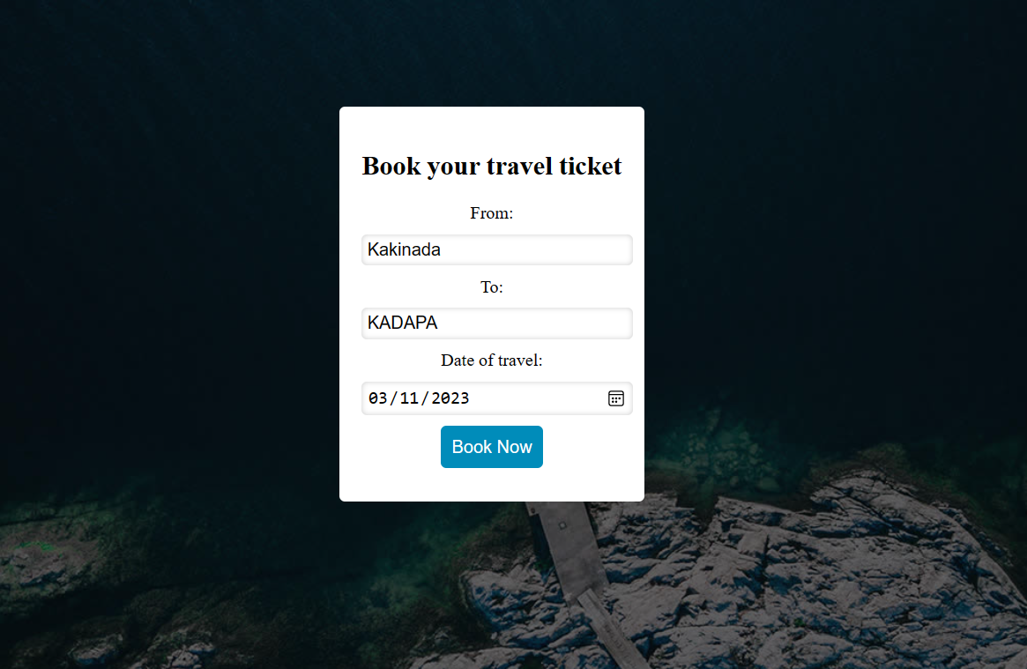
Few details to book ticket

Slide 7
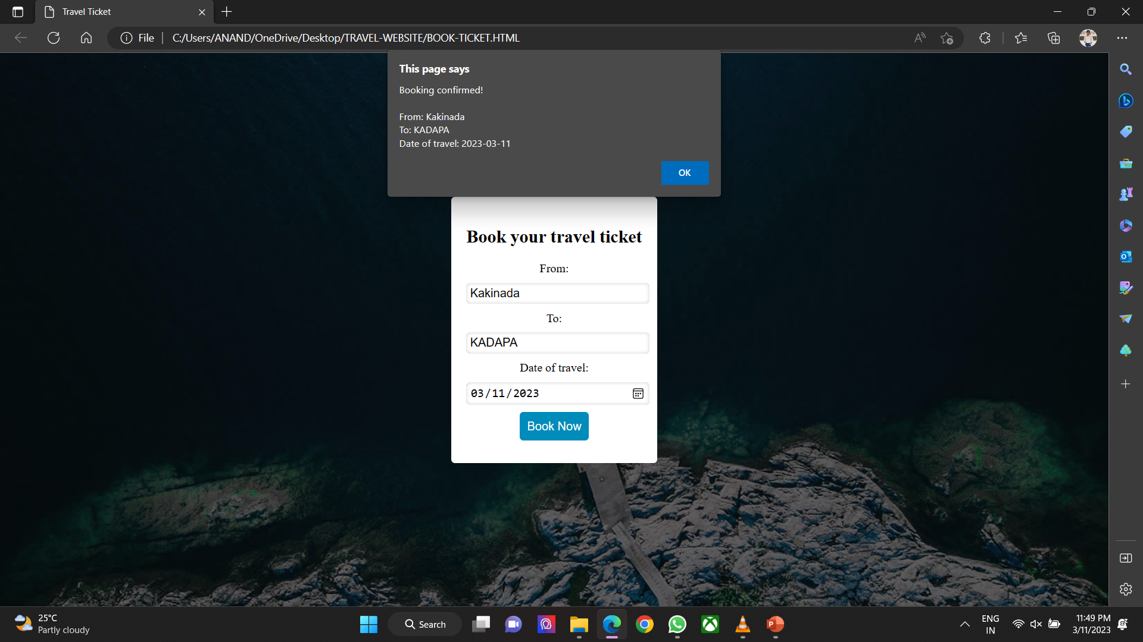
Instant booking confirm alert:-

Slide 8
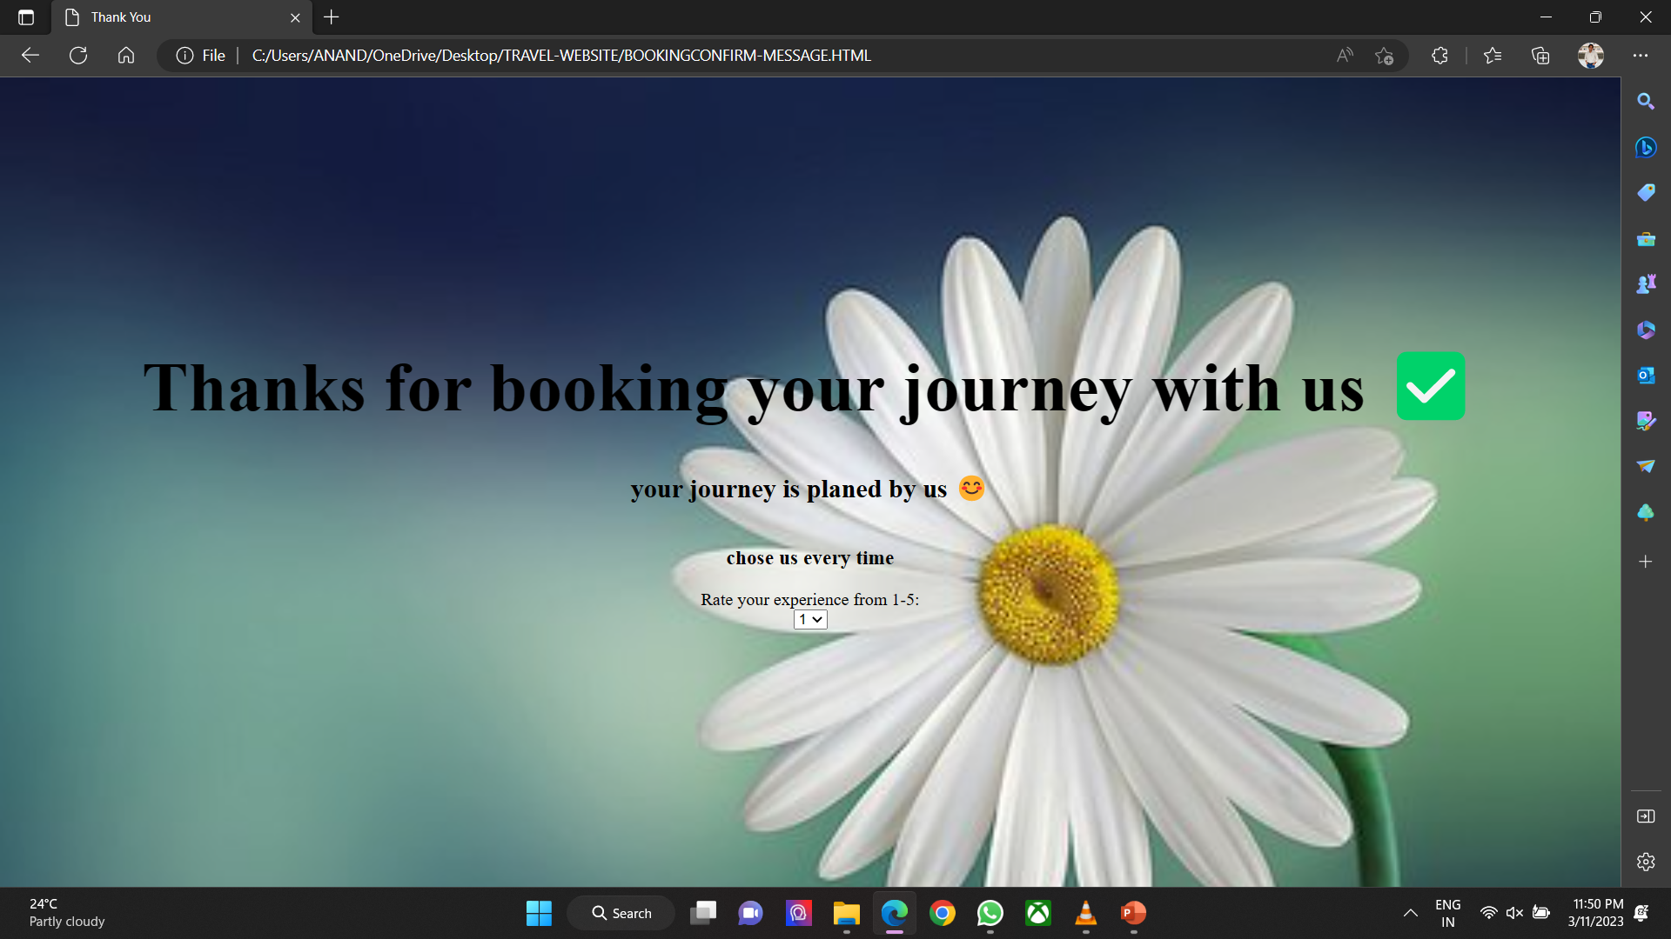
Thanking page :-

Slide 9

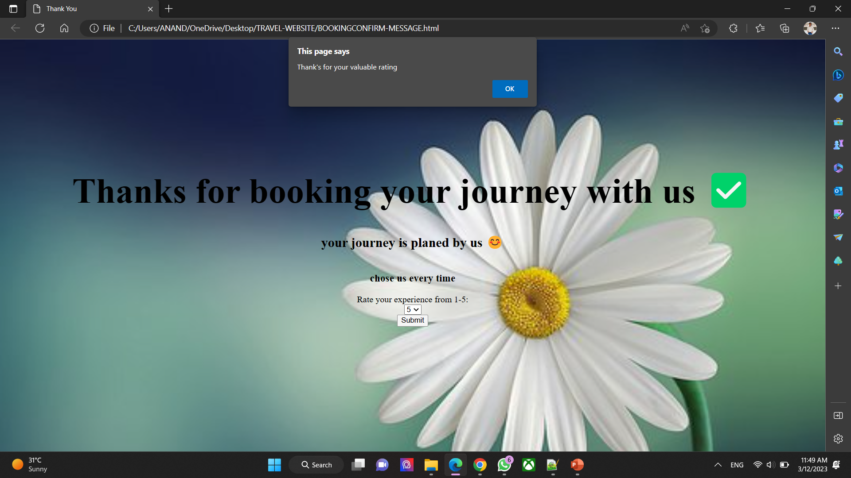
RATING :-

Slide 10
THANKS FOR YOUR INTREST
IT’S PLEASURE TO PRESENTOUR WORK WITH YOU:
Team 2

